Slide 1

Team Name : Targaryen
Team Leader Name : P.P.Sakthivel
Problem Statement : AI-Powered Personalized Learning & Productivity System for
Government Exam Aspirants.

Slide 2

About BharatPath AI
BharatPath AI is an AI-powered personalized learning and productivity platform for government exam aspirants in India. It provides verified exam notifications, welfare scheme updates, personalized eligibility analysis, and intelligent study assistance in regional languages, helping students easily understand and manage important information.
The platform solves key challenges such as lack of proper guidance, unstructured study plans, language barriers, and low preparation efficiency. Using artificial intelligence, BharatPath AI creates customized learning paths and delivers smart reminders to improve focus, time management, and overall exam performance. Our mission is to make exam preparation more accessible, organized, and effective for every student.

Slide 3
Uniqueness of Our Solution
Instant personalized recommendations
AI-based eligibility matching
What Makes Us Different
Fake notification filtering
Only verified, authentic sources
Personalized study assistant
Smart Study Planner (Goal-Based Preparation)
Most students don’t know what to study daily.
Custom learning paths
Regional language support
AI-based eligibility matching
Instant personalized recommendation
Breaking language barriers
Smart deadline alerts
One platform for all opportunities
Never miss important dates
Unified experience
Unlike existing portals, BharatPath AI uses Artificial Intelligence to personalize opportunities and guide students step-by-step through their journey.

Slide 4
Key Features
Profile-Based Recommendations
AI Chat Assistant
Exam & Scheme Alerts
Mock Tests
24/7 intelligent support for queries and guidance
Practice exams with detailed performance analytics
Smart matching based on qualifications, location, and preferences
Real-time push notifications for deadlines and updates
Notes Generator
Weak Area Detection
AI-generated study materials tailored to each exam
Identifies knowledge gaps and suggests improvement paths

Slide 5
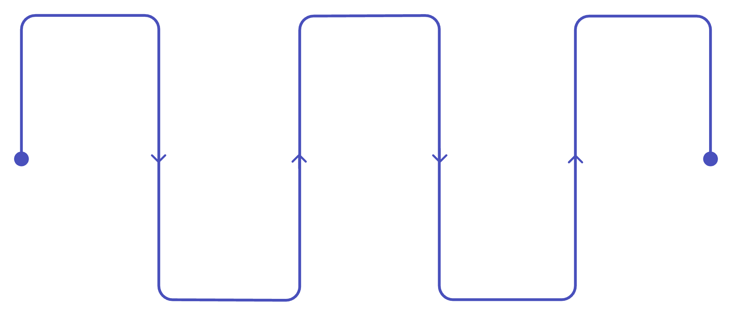
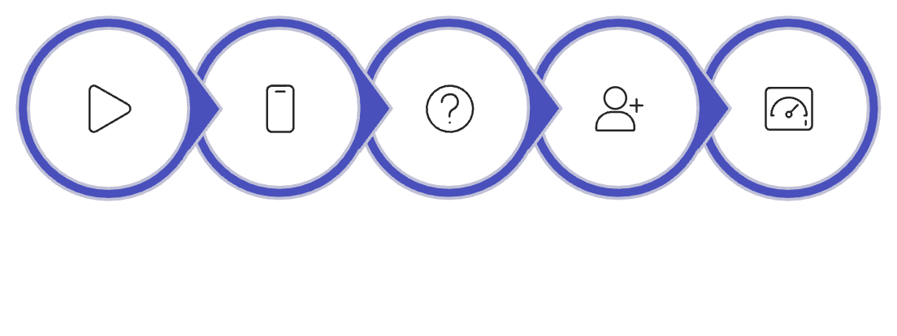





Flow Diagram
Sources
Clean & Validate
Storage
Firestore
Database.
Government websites & PDFs
Normalize and check data
Ingestion
AI Engine
Scraper, PDF parser, OCR
Summarize, tag, translate
User Flow Diagram
Start
Open App
New User?
Onboard
Dashboard

Slide 6
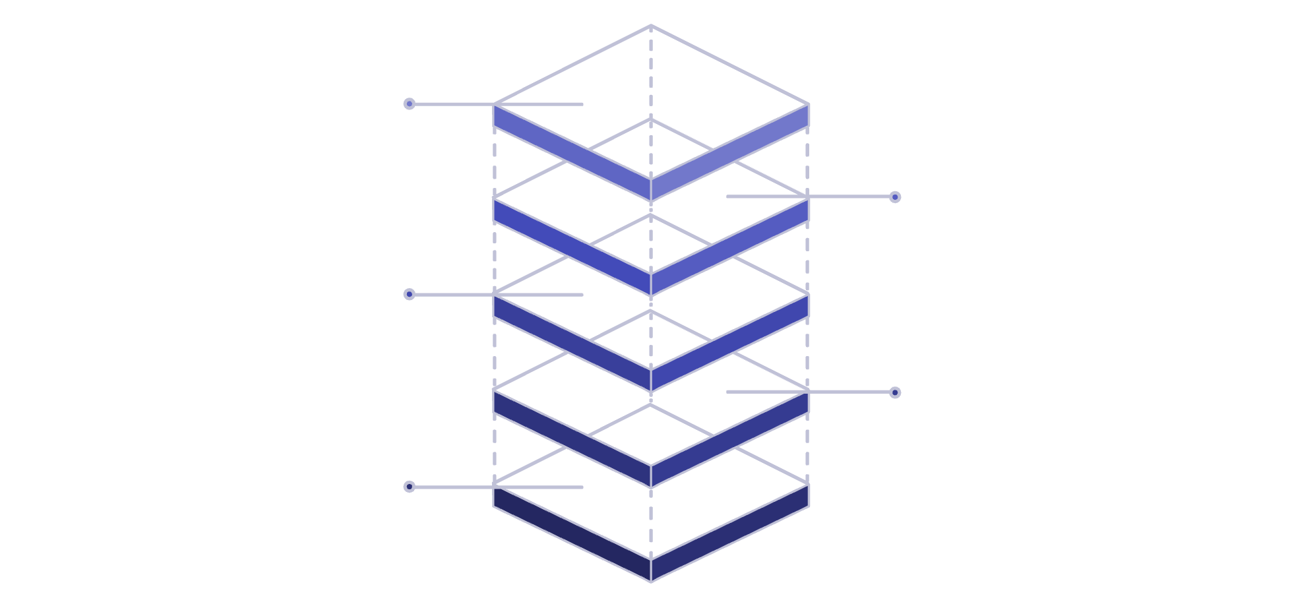
System Architecture
Services & Storage
Microservices, AI, Data, Storage
API Gateway
Frontend Hosting
React and Flutter apps
Cloud Gateway
Users
Web clients

Slide 7
Technologies Used
Key Technology Benefits
Technology Stack
Scalability
FRONTEND
DATA & STORAGE
1
4
Firebase/Firestore
Cloud Storage
React.js
TypeScript
Security
BACKEND
INFRASTRUCTURE
Performance
2
Docker
Firebase Hosting
Netify
Node.js
Express.js
5
Accessibility
AI & ML
Cost-Effective
ADDITIONAL TOOLS
3
LLM
NLP
Hugging Face
6
FCM
OCR
Web Scraping Tools
Git
Real-time

Slide 8
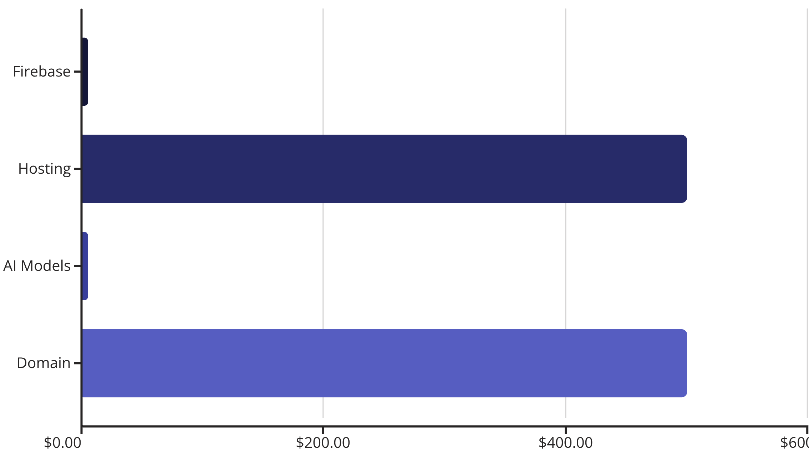
Cost Estimation
Low-Cost MVP Approach
Our initial implementation leverages free-tier cloud services and open-source technologies to minimize costs while maximizing impact.
₹1K
100%
Total Annual Cost
Open Source
AI models with no licensing fees
Minimal investment for maximum social impact
As the platform scales, we'll optimize infrastructure costs through strategic partnerships and government support programs.

Slide 9


